Slide 1
Database System
Lecture 2
Chapter # 6
Basic SQL
Alina Arshad
alina.arshad@nu.edu.pk

Slide 2
Giving Names to Constraints
Syntax:
CONSTRAINT CONSTRAINT_NAME CONSTRAINT_TYPES
CONSTRAINT: Keyword
CONSTRAINT_NAME: Name of the constraint

Slide 3
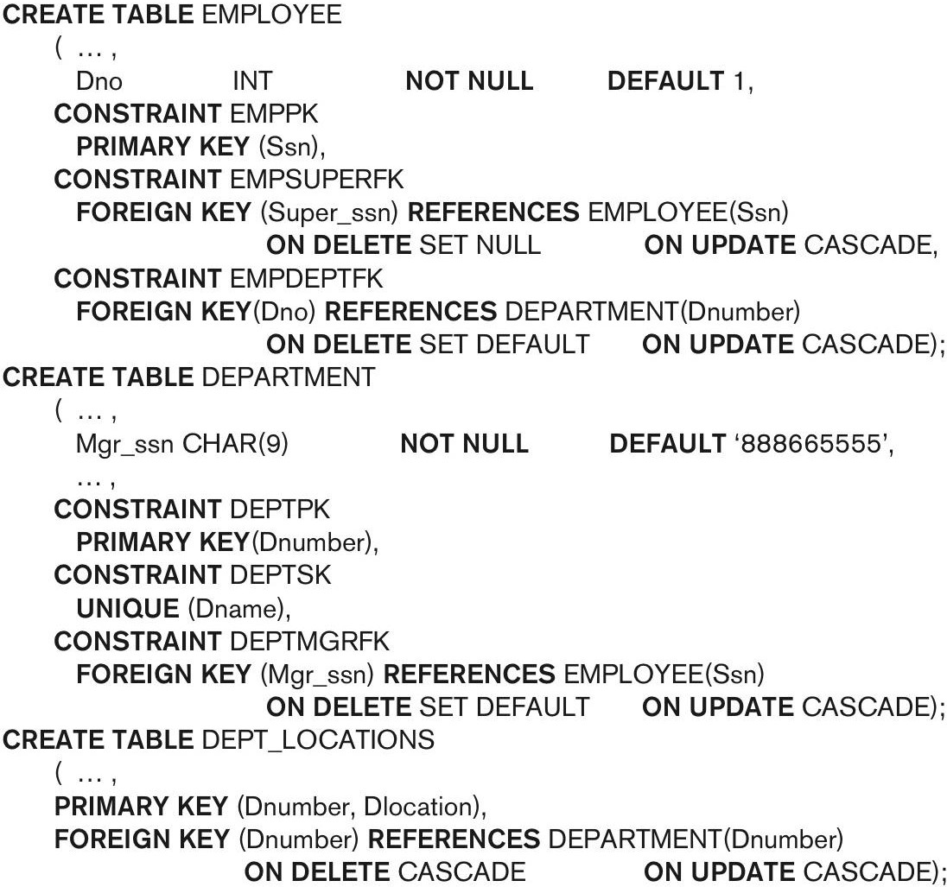

Slide 4
Example
Consider the following relations for a database that keeps track of business trips of salespersons in a sales office:
SALESPERSON(Ssn, Name, Start_year, Dept_no)
TRIP(Ssn, From_city, To_city, Departure_date, Return_date, Trip_id)
EXPENSE(Trip_id, Account#, Amount)
SSN can be upto four digits.
Start year and Department number of Salesperson must not be
null.
From_city, To_city, Departure_date, Return_date must not be null.
Trip_id and amount can be upto 6 digits.
Account # must be of 14 digits.

Slide 5
Basic SQL Queries: The SELECT- FROM-WHERE Structure
SELECT <attribute list> FROM <table list> WHERE <condition>; OR
SELECT <column1>, <column2>…..<column n> FROM <table1>;
Where
<attribute list> is a list of attribute names whose values are to be retrieved by the query.
<table list> is a list of the relation names required to process the query.
<condition> is a conditional (Boolean) expression that identifies the tuples to be retrieved by the query.

Slide 6
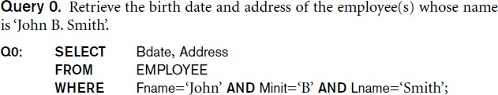
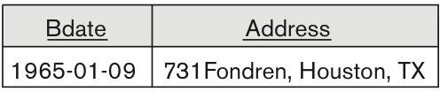
Basic SQL Queries: The SELECT- FROM-WHERE Structure
Logical comparison operators in SQL
• =, <, <=, >, >=, and <>
Sample Query

Slide 7
Unspecified WHERE Clause and Use of the Asterisk
Missing WHERE clause Indicates no condition on tuple selection, all the tuples are qualified for projection.
If more than one relation is specified in the FROM clause and there is no WHERE clause, then the CROSS PRODUCT—all possible tuple combinations—of these relations is selected.

Slide 8
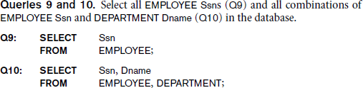
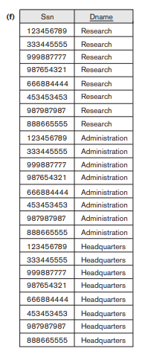


Slide 9
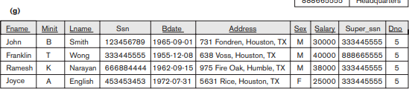
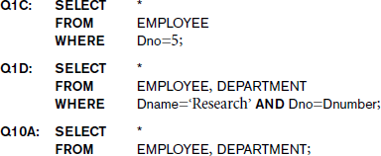
Unspecified WHERE Clause
and Use of the Asterisk (cont’d.)
Specify an asterisk (*) to retrieve all the attribute values of the selected tuples

Slide 10
INSERT, DELETE, and UPDATE Statements in SQL
INSERT: used to add a single tuple (row) to a relation (table).
INSERT INTO Syntax:
INSERT INTO table_name (col1,col2,col3,……)VALUES
(value1, value2, value3, ...);
INSERT INTO table_name VALUES (value1, value2,
value3, ...);

Slide 11
Demo Database
Customer ID | CustomerNam e | ContactNam e | Address | City | PostalCode | Country
89 | White Clover Markets | Karl Jablonski | 305 - 14th Ave. S. Suite 3B | Seattle | 98128 | USA
90 | Wilman Kala | Matti Karttunen | Keskuskatu 45 | Helsinki | 21240 | Finland
91 | Wolski | Zbyszek | ul. Filtrowa 68 | Walla | 01-012 | Poland
INSERT INTO Customers (CustomerName, ContactName, Address, City, PostalCode, Country)
VALUES ('Cardinal', 'Tom B. Erichsen', 'Skagen 21', 'Stavanger', '4006', 'Norway');

Slide 12
Query Result
Customer ID | Customer Name | ContactNa me | Address | City | PostalCod e | Country
89 | White Clover Markets | Karl Jablonski | 305 - 14th Ave. S. Suite 3B | Seattle | 98128 | USA
90 | Wilman Kala | Matti Karttunen | Keskuskat u 45 | Helsinki | 21240 | Finland
91 | Wolski | Zbyszek | ul. Filtrowa 68 | Walla | 01-012 | Poland
92 | Cardinal | Tom B. Erichsen | Skagen 21 | Stavanger | 4006 | Norway

Slide 13
SQL INSERT INTO SELECT Statement
The INSERT INTO SELECT statement copies data from one table and inserts it into another table.
The INSERT INTO SELECT statement requires that the data types in source and target tables matches.
Copy all columns from one table to another table:
INSERT INTO table2 SELECT * FROM table1 WHERE condition;
Copy only some columns from one table into another table:
INSERT INTO table2 (column1, column2, column3, ...) SELECT column1, column2, column3, ...
FROM table1
WHERE condition;

Slide 14
Demo Database
CustomerID | CustomerName | ContactName | Address | City | PostalCode | Country
1 | Alfreds Futterkiste | Maria Anders | Obere Str. 57 | Berlin | 12209 | Germany
2 | Ana Trujillo Emparedados y helados | Ana Trujillo | Avda. de la Constitución 2222 | México D.F. | 05021 | Mexico
3 | Antonio Moreno Taquería | Antonio Moreno | Mataderos 2312 | México D.F. | 05023 | Mexico
And a selection from the "Suppliers" table:
SupplierID | SupplierName | ContactName | Address | City | Postal Code | Country
1 | Exotic Liquid | Charlotte Cooper | 49 Gilbert St. | Londona | EC1 4SD | UK
2 | New Orleans Cajun Delights | Shelley Burke | P.O. Box 78934 | New Orleans | 70117 | USA
3 | Grandma Kelly's Homestead | Regina Murphy | 707 Oxford Rd. | Ann Arbor | 48104 | USA

Slide 15
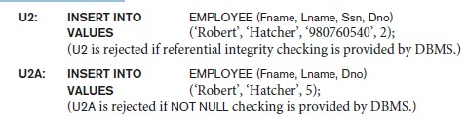
Example
INSERT INTO Customers (CustomerName, City, Country) SELECT SupplierName, City, Country FROM Suppliers;
Example
INSERT INTO Customers (CustomerName, City, Country) SELECT SupplierName, City, Country FROM Suppliers WHERE Country='Germany';

Slide 16
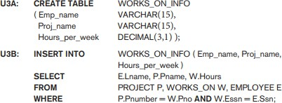
INSERT INTO SELECT

Slide 17
Any question????

